Slide 1
Topics to Cover
Computer Security Basics
Security Goals
Security Attacks
Security Services
Security Mechanisms
Security Techniques

Slide 2
COMPUTER SECURITY BASICS

Slide 3
What’s Information
Information is processed data that has meaning, context, and relevance.
It supports decision-making by providing useful knowledge to users.
Information can exist in many forms, such as text, images, audio, video, and digital files.
Information is a valuable asset that must be protected from unauthorized access, modification, or loss.

Slide 4
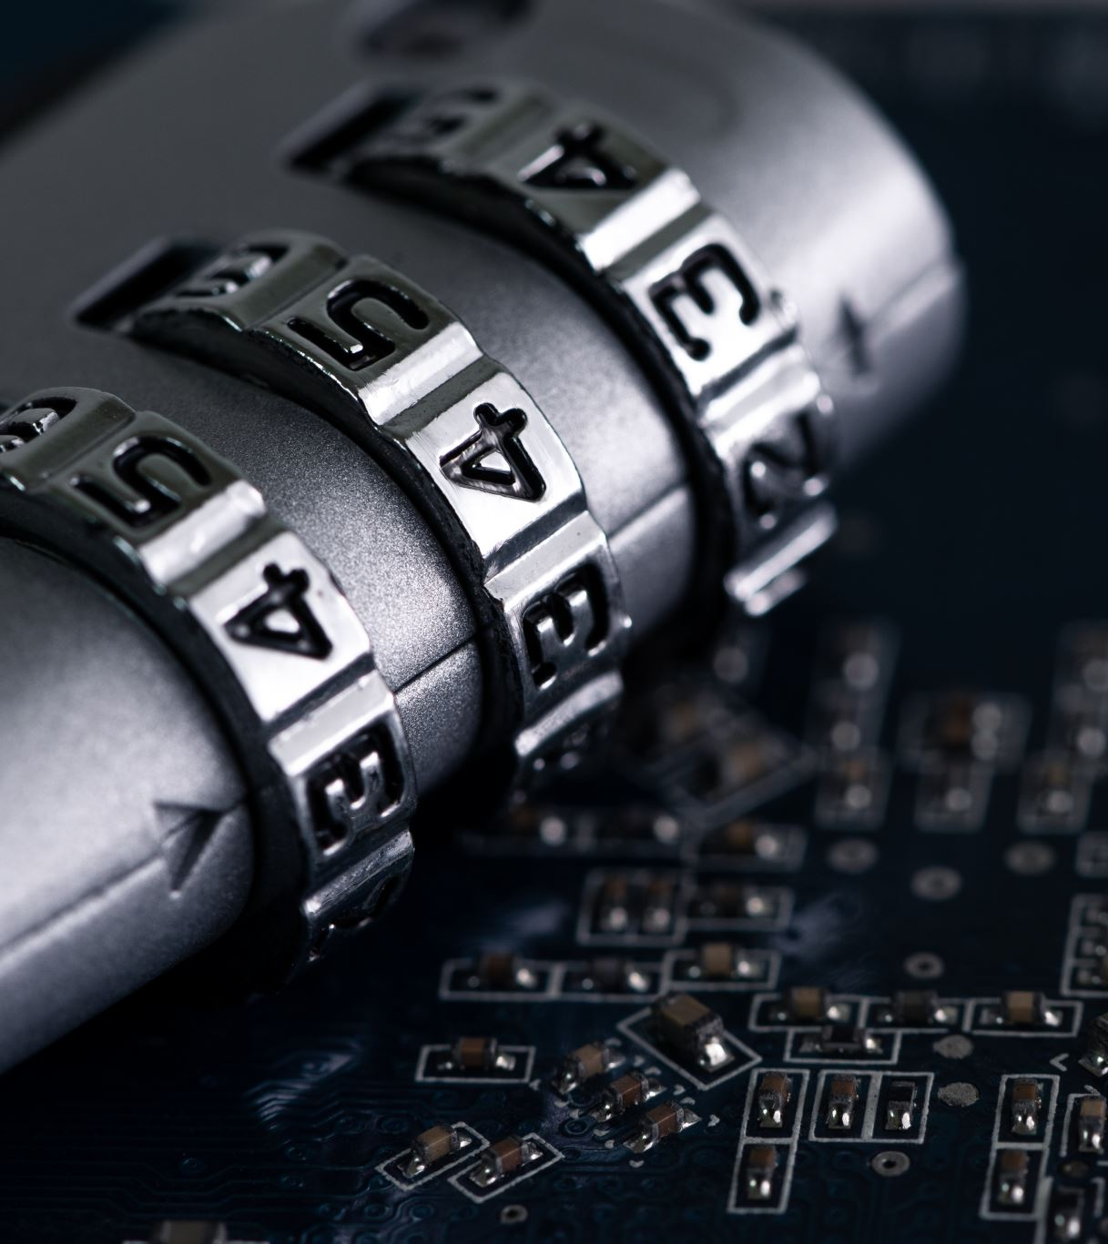
What’s Computer Security
Also known as Cyber Security
Practice of Protection of stored and transmitted data
Used to preserve different security goals (Confidentiality, Integrity, Availability, etc.) of the data from an adversary or a group of adversaries.

Slide 5
SECURITY GOALS

Slide 6
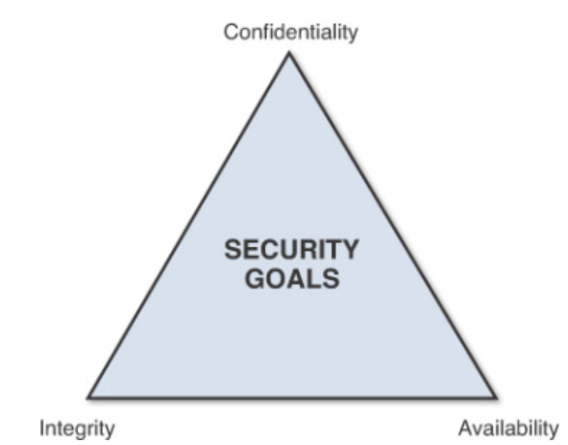
Security goals defined by FIPS 199
FIPS (Standards for Security Categorization of Federal Information and Information Systems)
CIA Triad defined by FIPS

Slide 7
Confidentiality (🔒)
Ensures that sensitive information is accessed only by authorized individuals, entities, or processes.
It protects data from unauthorized disclosure.

Slide 8
Integrity (✔️)
Ensures that data is not tampered with and remains in its original state, providing assurance that the information is trustworthy and accurate.
Data can be changed only by authorized entities.

Slide 9
Availability (🕒)
Ensures that information, systems, and services are accessible and usable upon demand by authorized users.
Timely access to Google Drive, One Drive backups, etc.

Slide 10
2 Additional Security Goals
Authenticity (🔑):-
Ensures that an entity (user, device, or system) is who or what it claims to be.
Some examples could be Password based, Biometric based, etc.
Accountability (📜):-
Mechanisms which ensure that individuals or communicating entities can be held responsible for their actions.

Slide 11
SECURITY ATTACKS

Slide 12
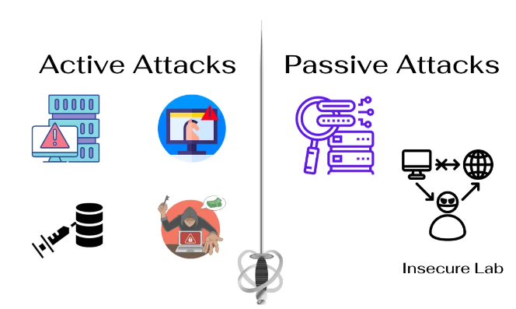
Security Attacks

Slide 13
Security Attacks
Passive
Active
Snooping
Modification
Masquerading
Traffic Analysis
Replaying
Repudiation
Denial of Service (DoS)

Slide 14
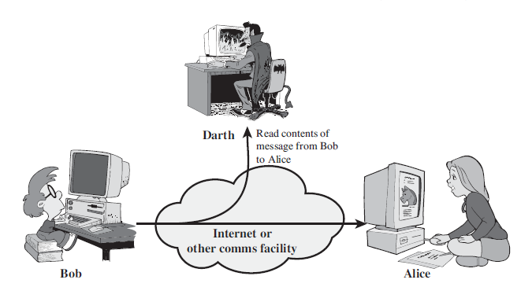
Snooping
Captures and reads sensitive data transmitted across a network.
The attacker concentrates on contents of the data.

Slide 15
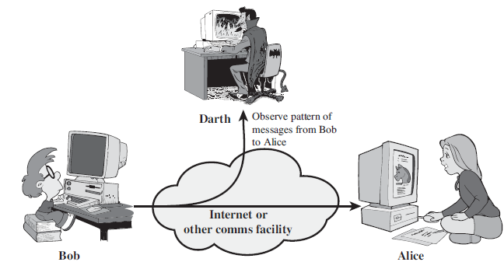
Traffic Analysis
The attacker collects information and analyzes the network communication patterns.
Concentrates on Metadata and traffic flow in a network.

Slide 16
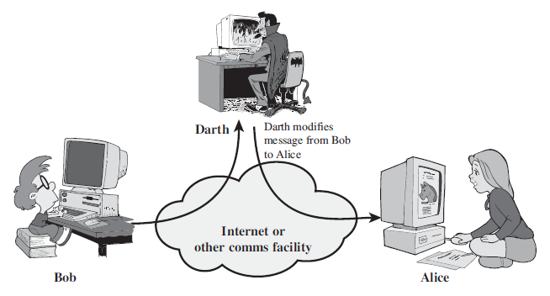
Modification
Unauthorized manipulation, tampering, etc., of the legitimate data communicated over a network.

Slide 17
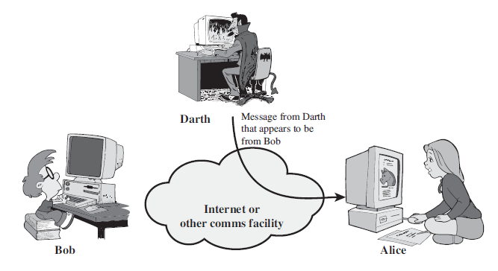
Masquerading
Attacker pretends to be a legitimate entity to other legitimate entities in a network.

Slide 18
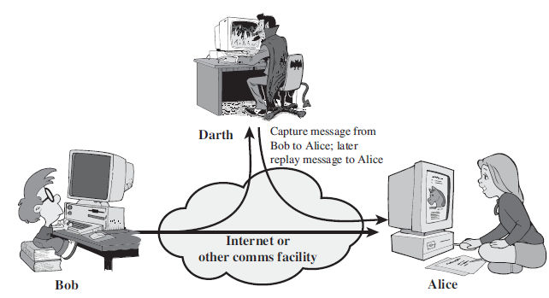
Replaying
Subsequent retransmissions of a previously captured data packet.

Slide 19
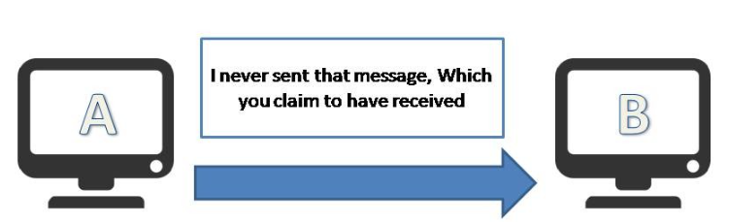
Repudiation
Denying the fact that an entity was involved in a data communication.

Slide 20
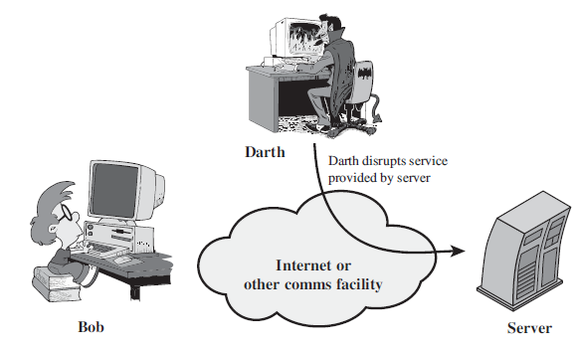
DoS
The attacker degrades a computer network by overloading it with unnecessary data traffic.

Slide 21
Passive Attacks | Active Attacks
Eavesdropping and/or Collecting Data | Altering/Manipulating Data
Zero/Negligible impact on the system operations and/or the network performance. | Major impact on the system operations and/or the network performance
Comparatively harder to detect | Comparatively easier to detect

Slide 22
SECURITY SERVICES

Slide 23
Security Services
Peer Entity Authentication
Data Origin Authentication
Access Control
Confidentiality
Data Integrity
Non-Repudiation
Availability

Slide 24
Security Services (Contd..)
Peer Entity Authentication:- Verification of the identities of the communicating entities.
Data Origin Authentication:- Verification of the source of the data, and that it is from a legitimate communicating entity.
Access Control:- Mechanisms and Policies which are defined to manage and restrict access to resources and data.
Confidentiality:- Includes 4 types of Confidentiality (Connection Confidentiality, Connectionless Confidentiality, Selective-Field Confidentiality, and Traffic Flow Confidentiality)

Slide 25
Security Services (Contd..)
Data Integrity:- Involves 5 types (Connection Integrity with Recovery, Connection Integrity without Recovery, Selective-Field Connection Integrity, Connectionless Integrity, and Selective-Field Connectionless Integrity)
Non-Repudiation:- 2 types (for Origin, and for Destination)
Availability

Slide 26
SECURITY MECHANISMS

Slide 27
Security Mechanisms
Encipherment
Digital Signature
Access Control
Data Integrity
Authentication Exchange
Traffic Padding
Routing Control
Notarization

Slide 28
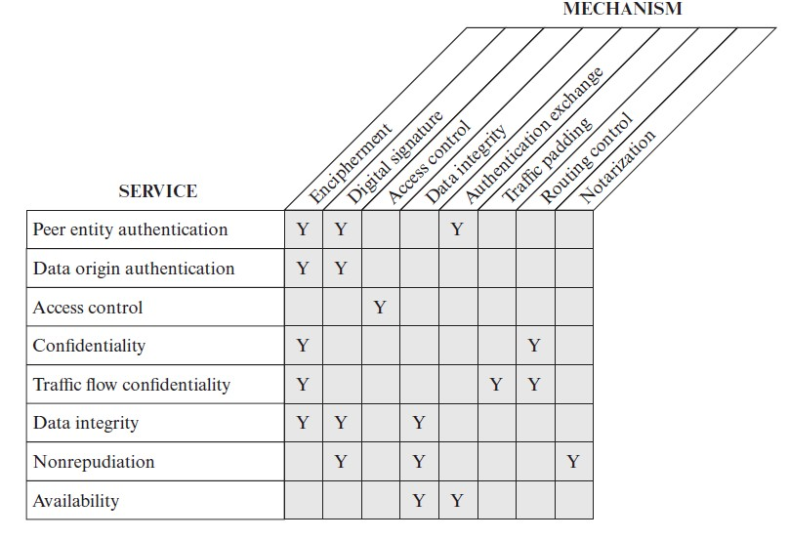
Relationship between Security Services and Security Mechanisms

Slide 29
SECURITY TECHNIQUES

Slide 30
Cryptography vs Steganography
Cryptography | Steganography
Hides the contents of an information. | Hides the existence of an information.
Produces unreadable ciphertext. | Produces a normal-looking file containing hidden data.
Anyone can see encrypted data exists. | Observers may not realize a secret message exists.
Example: AES-encrypted file | Example: Secret text embedded in an image

Slide 31
What’s Cryptography

Slide 32
What’s Cryptography (Contd..)
Aspect | Description
Definition | Science and art of securing messages by transforming them into a protected form.
Purpose | Implements security mechanisms to protect information from attacks.
Origin | Greek: kryptos (secret) + graphein (writing) → "Secret writing."
Key Techniques | Symmetric-Key Encipherment, Asymmetric-Key Encipherment, Hashing

Slide 33
Types of Steganography
Type | Description
Text | Hides data in text using spaces, punctuation, or formatting.
Image | Embeds data in image pixels (e.g., LSB).
Audio | Conceals data within digital audio samples.
Video | Hides data in video frames or audio tracks.
Network | Embeds data in network packets or protocol headers.

Slide 34
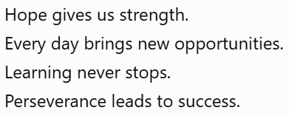
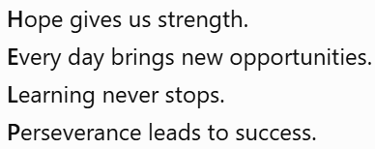
Text Cover (Examples)

Slide 35
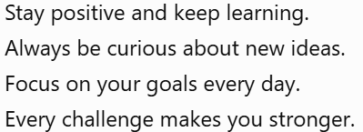
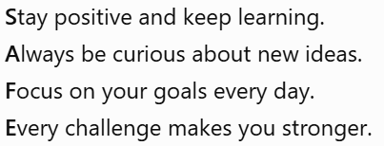
Text Cover (Examples) (Contd..)

Slide 36
Text Cover (Examples) (Contd..)
Text Covers
Data|is||secure|when|encrypted|using|modern|algorithms.||Today
Computers|have||become|an|essential|part|of|everyday||life.
Security|protects||valuable|data|from|cyber||attacks|every|day
Security|protects||valuable|data|from|cyber||attacks|every||day

Slide 37
Text Cover (Examples) (Contd..)
Sentence Pattern | Word | Encoded Bits
Article | A | 0
Noun | friend | 10010
Verb | called | 0001
Article | a | 0
Noun | doctor | 01001

Slide 38
Image Cover (Examples)
Pixel | Red | Green | Blue
P1 | 120 | 200 | 45
P2 | 34 | 150 | 220
P3 | 78 | 66 | 190
Pixel | Red | Green | Blue
P1 | 120 | 201 | 44
P2 | 34 | 150 | 220
P3 | 78 | 67 | 190

Slide 39
Image Cover (Examples)
Pixel | Red | Green | Blue
P1 | 120 | 200 | 45
P2 | 34 | 22 | 92
P3 | 78 | 194 | 190

